Slide 1

Multimodal approaches

Slide 2
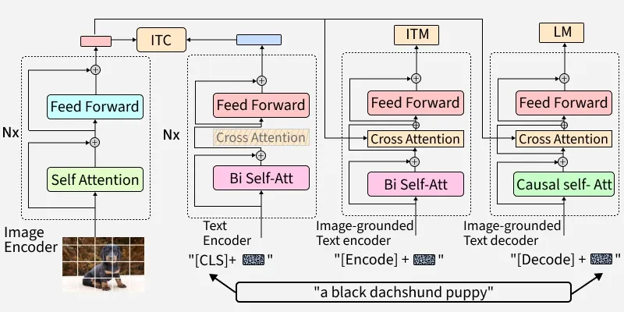
BLIP2 Architecture
Notes:
BLIP’s core structure is a multimodal encoder-decoder setup made for both understanding and generation tasks:
Unimodal Encoder: Separately encodes images and text.
Image-grounded Text Encoder: Integrates visual context into text encoding using cross-attention layers.
Image-grounded Text Decoder: Generates text from images with causal self-attention mechanisms. (1) Unimodal encoder, which separately encodes image and text. The text encoder is the same as BERT, where a [CLS] token is appended to the beginning of the text input to summarize the sentence.
(2) Image-grounded text encoder, which injects visual information by inserting one additional cross-attention (CA) layer between the self-attention (SA) layer and the feed forward network (FFN) for each transformer block of the text encoder. A task-specific [Encode] token is appended to the text, and the output embedding of [Encode] is used as the multimodal representation of the image-text pair.
(3) Image-grounded text decoder, which replaces the bidirectional self-attention layers in the image-grounded text encoder with causal self-attention layers. A [Decode] token is used to signal the beginning of a sequence, and an end-of-sequence token is used to signal its end.

Slide 3
Blip2 pretraining
Image-Text Contrastive Loss (ITC): Aligns visual and textual feature spaces, promoting similarity between matching image-text pairs while distinguishing negatives.
Image-Text Matching Loss (ITM): Encourages detailed multimodal representation with a classification task, determining if a text matches an image.
Language Modeling Loss (LM): Trains the model to generate plausible text from images using an autoregressive approach.

Slide 5
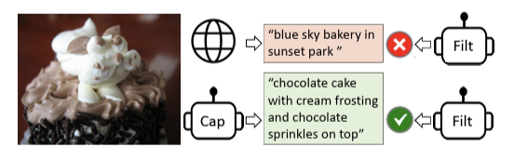
Pretraining details
pre-train on image-text pairs collected from the web
- used Captioner (Cap) to generate synthetic captions for web images, and a Filter (Filt) to remove noisy captions.

